Slide 1

Yelp Reviews of Philadelphia Restaurants
DSBA/MBAD 6211: Group Project
By Jacob Crisp, Jeffery Sengsy, Kush Bhuva, Siddhant Agarwal, and Denys Nsanzimana

Slide 2

Background
We chose Option 4: Yelp Open Dataset and limited the data to restaurants in Philadelphia and reviews from 2012 to 2022. Philadelphia’s dining landscape is thriving, blending historic culinary traditions with innovative concepts. According to Yelp data and industry analyses:
Scale & Density: Our Philadelphia data set has over 5,800 restaurants, averaging 45 restaurants per square mile, making it one of the most vibrant food cities in the U.S.
Consumer Behavior: Online reviews play a major role in dining decisions—67% of millennials and 52% of Gen Z diners choose new restaurants based on positive online feedback, with Yelp being a leading influence.
Cuisine Diversity: Yelp data highlights strong representation of Italian, New American and Seafood cuisines, alongside a growing presence of Brunch/Coffee and Tee Spots.
Industry Momentum: Despite pandemic challenges, Yelp reports new restaurant openings up 6% year-over-year, signaling strong recovery and expansion

Slide 3
Assumptions
Restaurant Age
Since there was no variable to determine the age of a restaurant, we created a variable that takes into account the oldest review and if it was created after Jan of 2020, we would consider the restaurant to be ‘new’

Slide 4
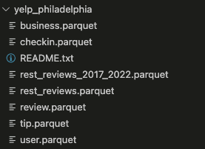
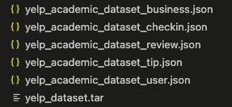
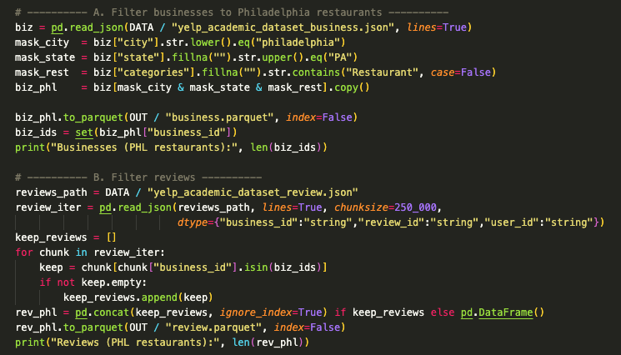
Data Extraction/Filtering
Extracting raw dataset from Yelp
Filtering for Philly restaurants only
Saving subset as Parquet files to save space vs csv
Using joins by “business_id and user_id” to connect tables

Slide 5
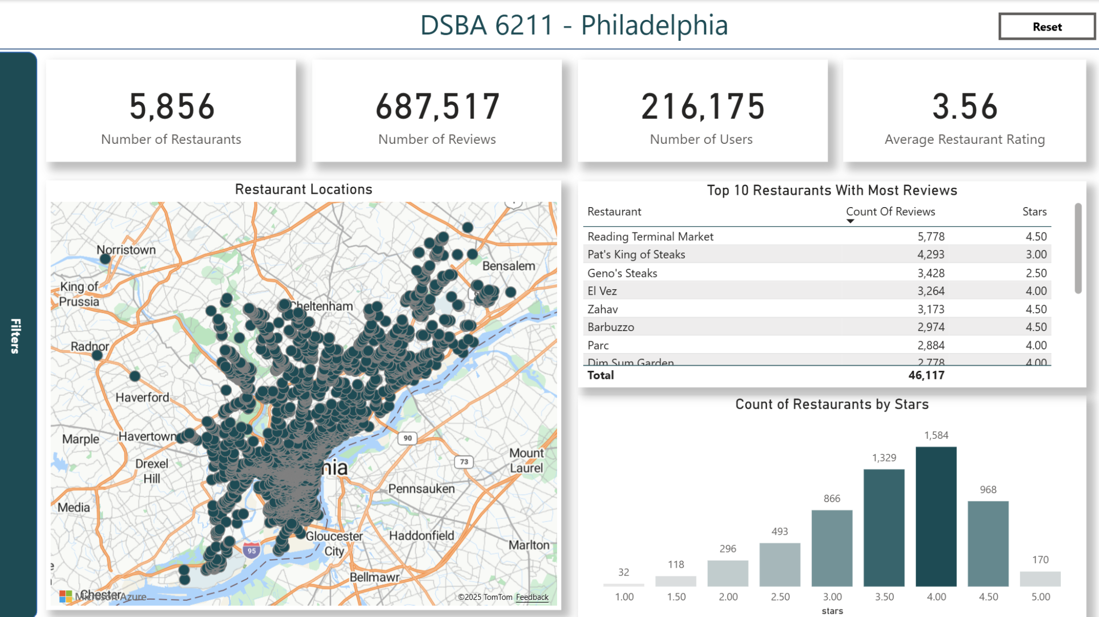
Power BI

Slide 6
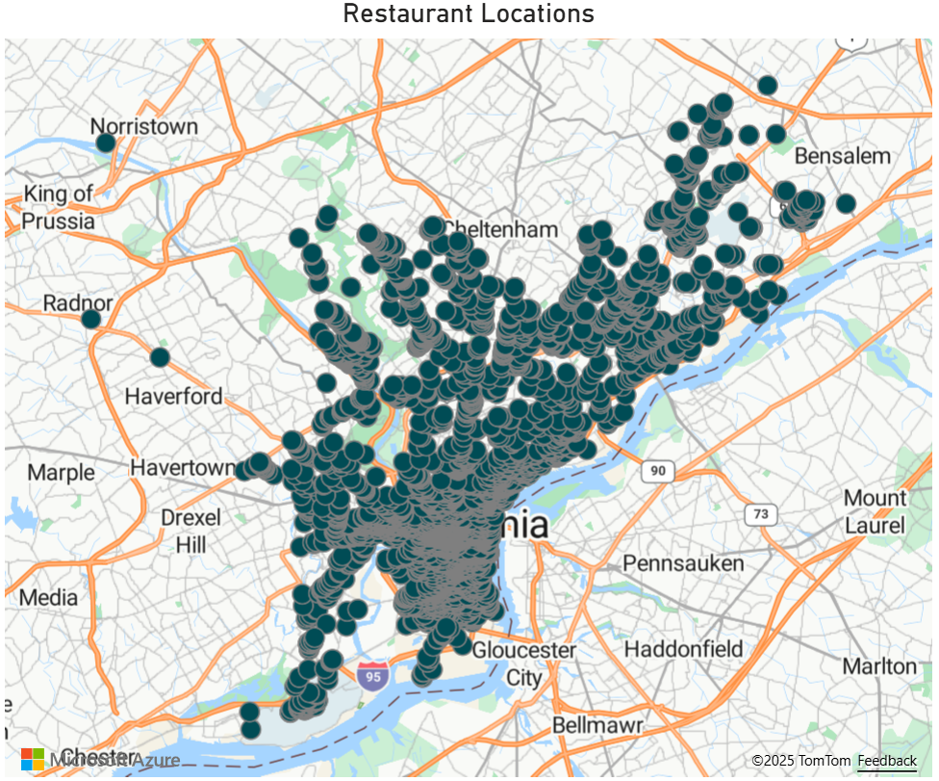
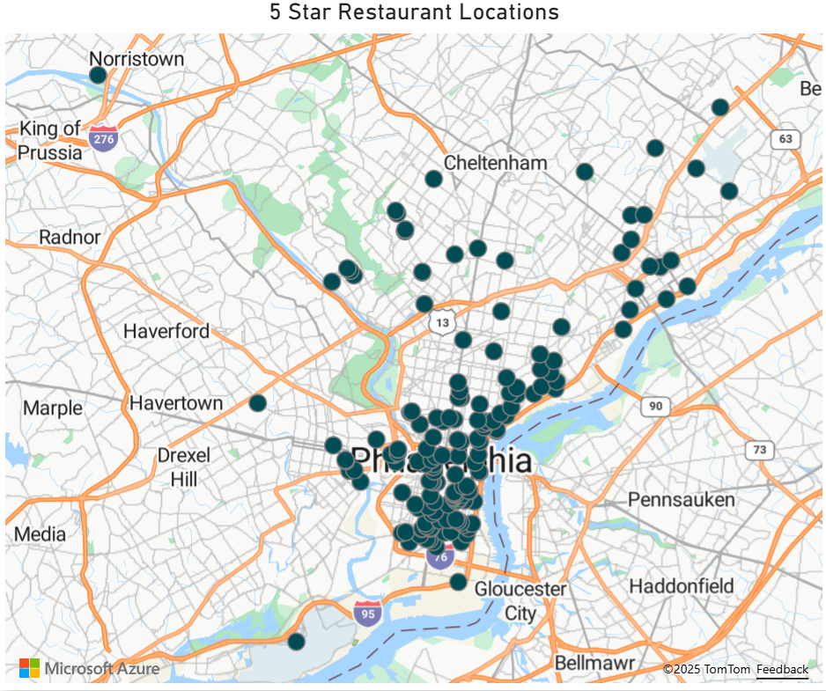
Location Analysis

Slide 7
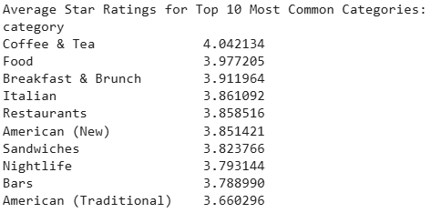
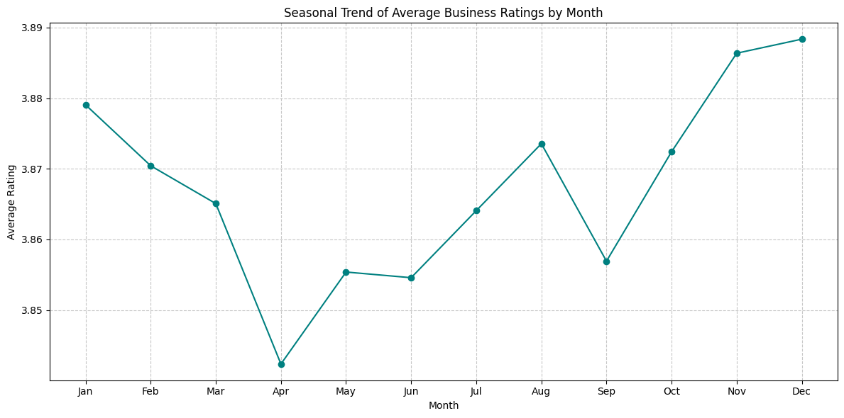
Exploratory Data Analysis

Slide 8
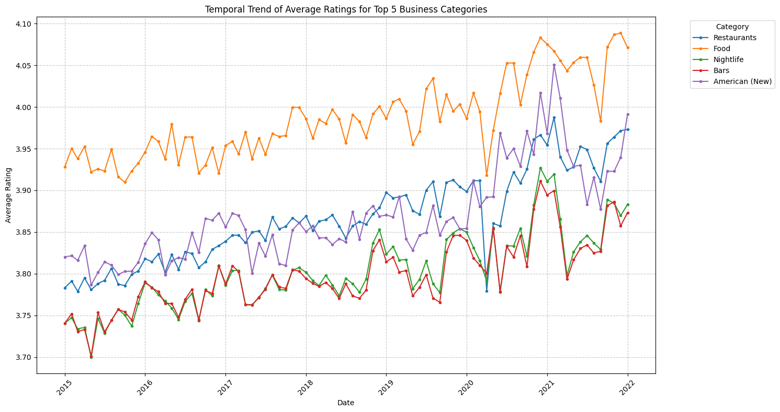
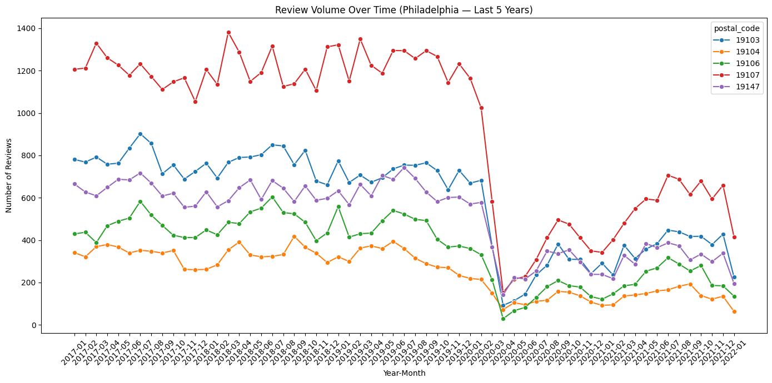
Reviews over time

Slide 9
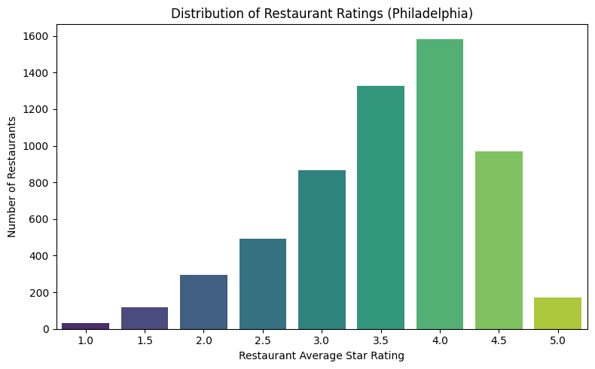
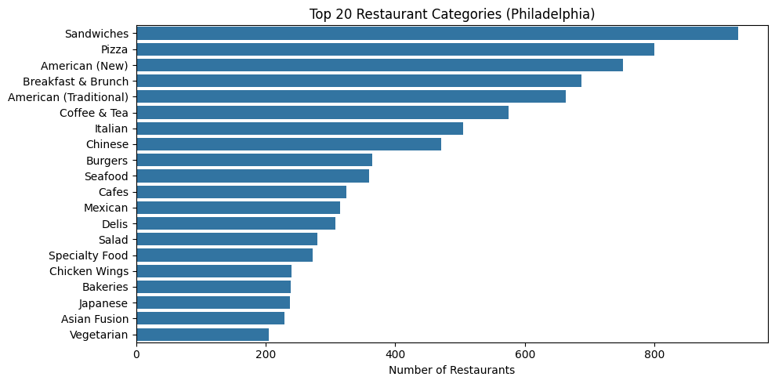
EDA Cont.

Slide 10
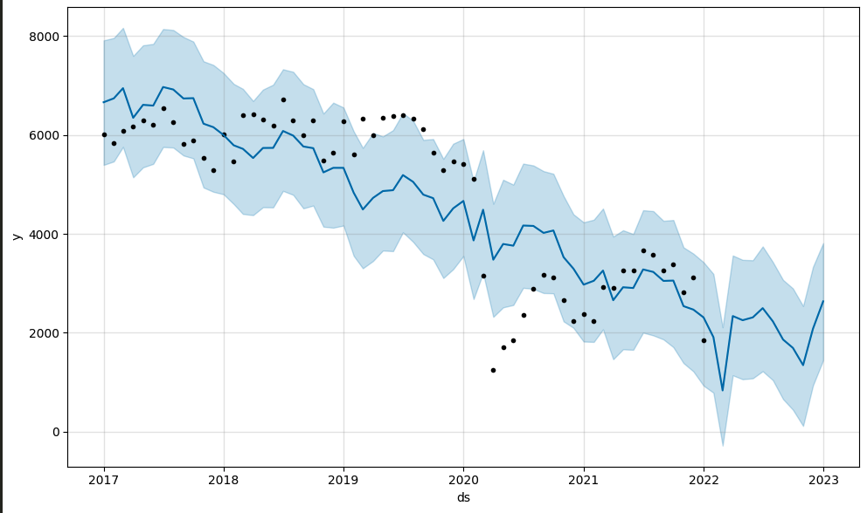
Time Series Model for review volumes
Legend:
Historical reviews - black dots
Trend + forecast - blue line
Uncertainty or upper/lower limits - shaded blue
Prophet model:
Trend changes
Seasonal patterns
Irregular behavior
Strong external shocks (like COVID)
Annually saw a downward trend in review volumes
Spikes show higher activity due to summer months
Covid shock then model predicts slow recovery

Slide 11
Predicting a Restaurant’s Overall Rating
Method - Log Regression
Target - Rating (4* or Higher)
Variables -
total_checkins
total_reviews
average_review_length
average_polarity
new_restauraurant (Custom Variable - if first review was left on/after Jan 2020)
Top food related categories (one-hot-coding)

Slide 12
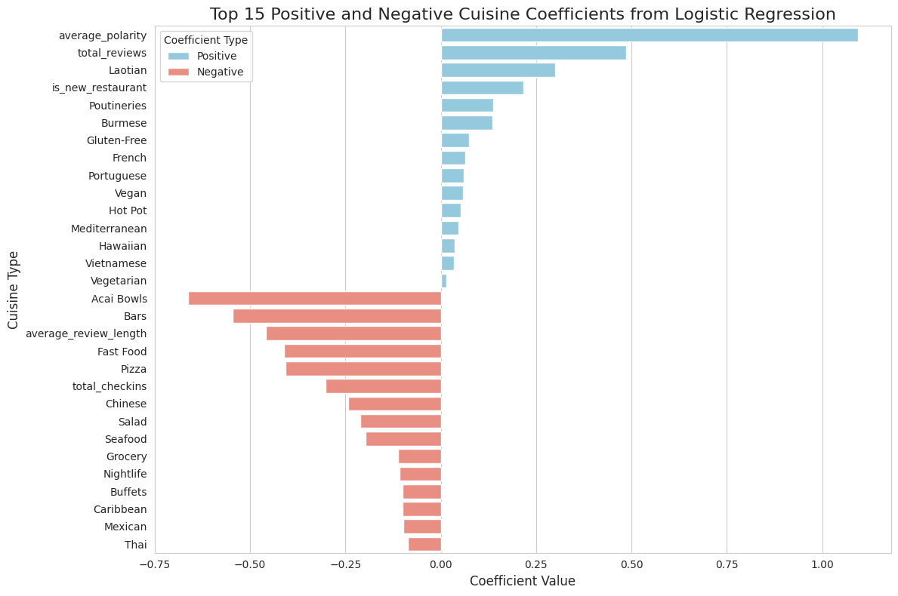
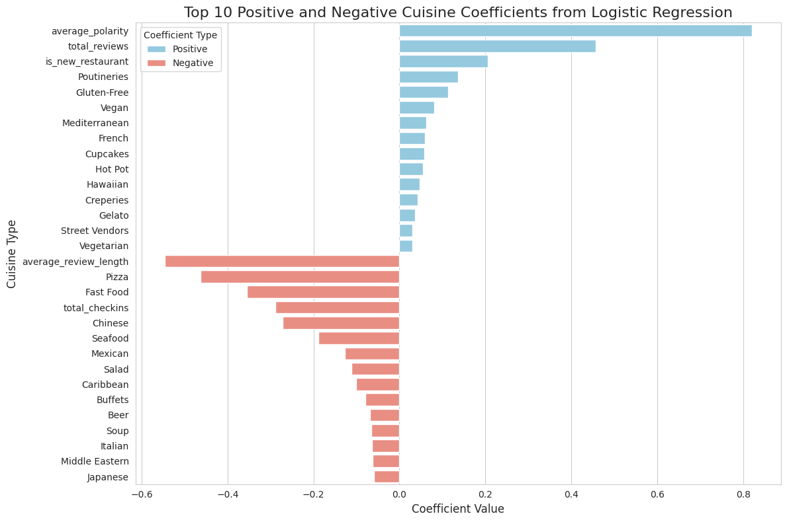
Predicting a Restaurant’s Overall Rating Cont.
Positive:
Polarity
High # Reviews
New Restaurants
Dietary Restrictions
Unique Cuisines
Negative:
Long Reviews
Pizza
Fast Food
High # Checkins
Bars/Nightlife

Slide 13
LLM Topic, Theme, & Sentiment Extraction
We used a large language model to extract topics, themes, and sentiments from reviews.
Models Used: Gemini and GPT 4o Mini
Limitations: We ran out of the student Colab Pro quota of LLM requests and were only able to extract topics from a sample of reviews. We sampled 500 from each year to run our analysis.
We learned that each user review typically mentions a variety of topics, and the sentiment of those topics within one review is often mixed. For example, the following review contains 9 topic categories with varying sentiments.
Review: Great option in University city for some tex mex style food. I really like their quesadillas, and my coworker loves their burritos.
Can be a little divey at times, sometimes the floor is a little sticky, and you get the occasional obnoxious diners who get too loud....but the food is always good, the staff is always friendly, and the margaritas (after work of course) are always a flowing!

Slide 14
topic_phrase | topic_sentiment | topic_category | Theme
coworker loves their burritos | positive | food item | Food Quality
really like their quesadillas | positive | food item | Food Quality
margaritas are always a flowing | positive | drink item | Menu Variety
staff is always friendly | positive | staff demeanor | Staff Interaction
Great option in University city | positive | location | Location
occasional obnoxious diners who get too loud | negative | noise level | Ambience
floor is a little sticky | negative | cleanliness | Cleanliness
Can be a little divey | negative | ambience | Ambience
tex mex style food | neutral | Cuisine type | Menu Variety
food is always good | positive | food quality | Food Quality

Slide 15
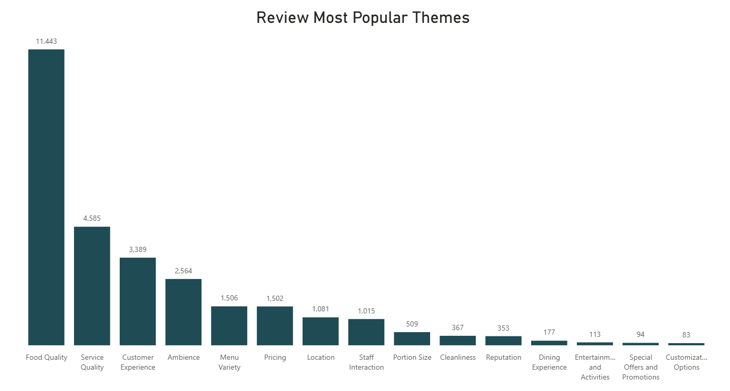

Slide 16
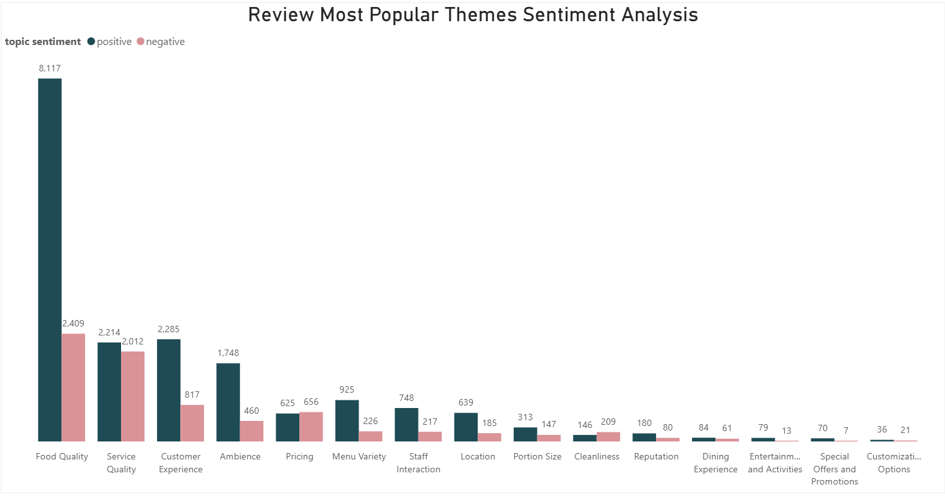

Slide 17
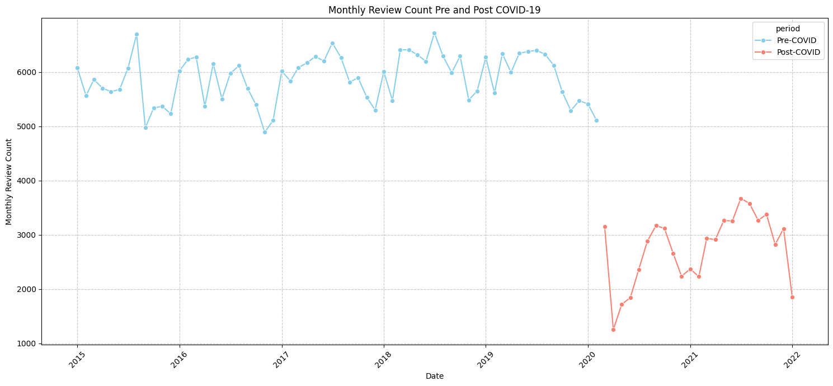
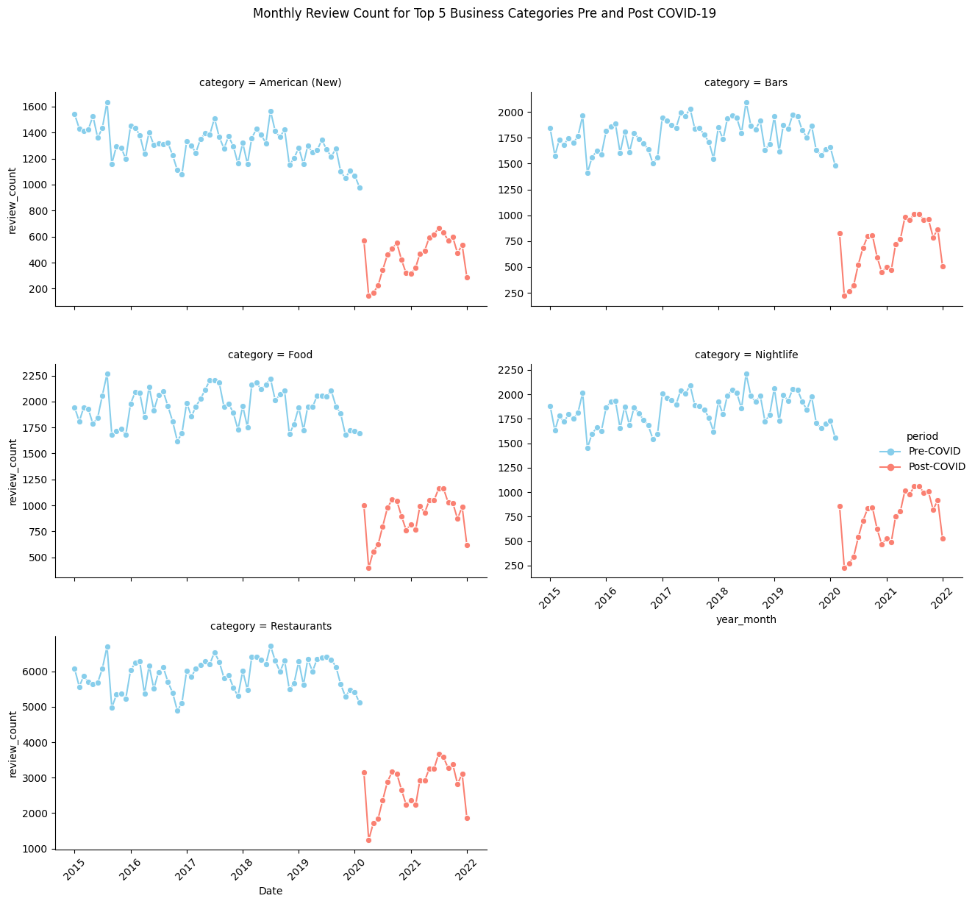
Pandemic Shock Analysis - Review Frequency

Slide 18
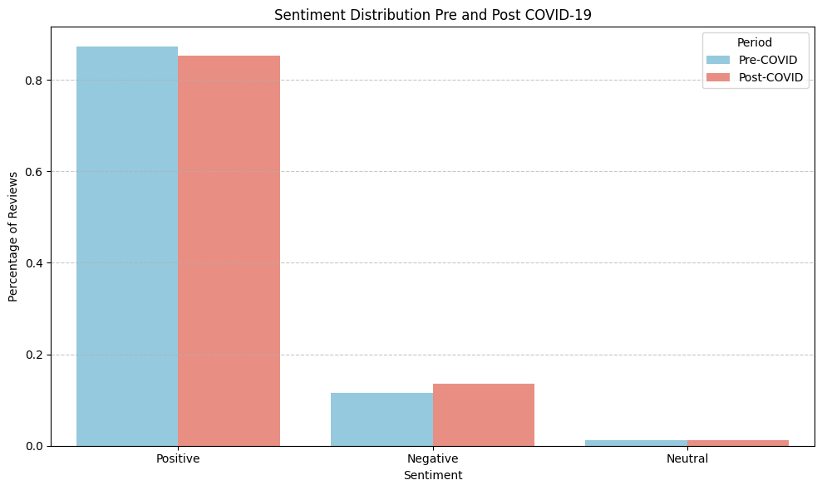
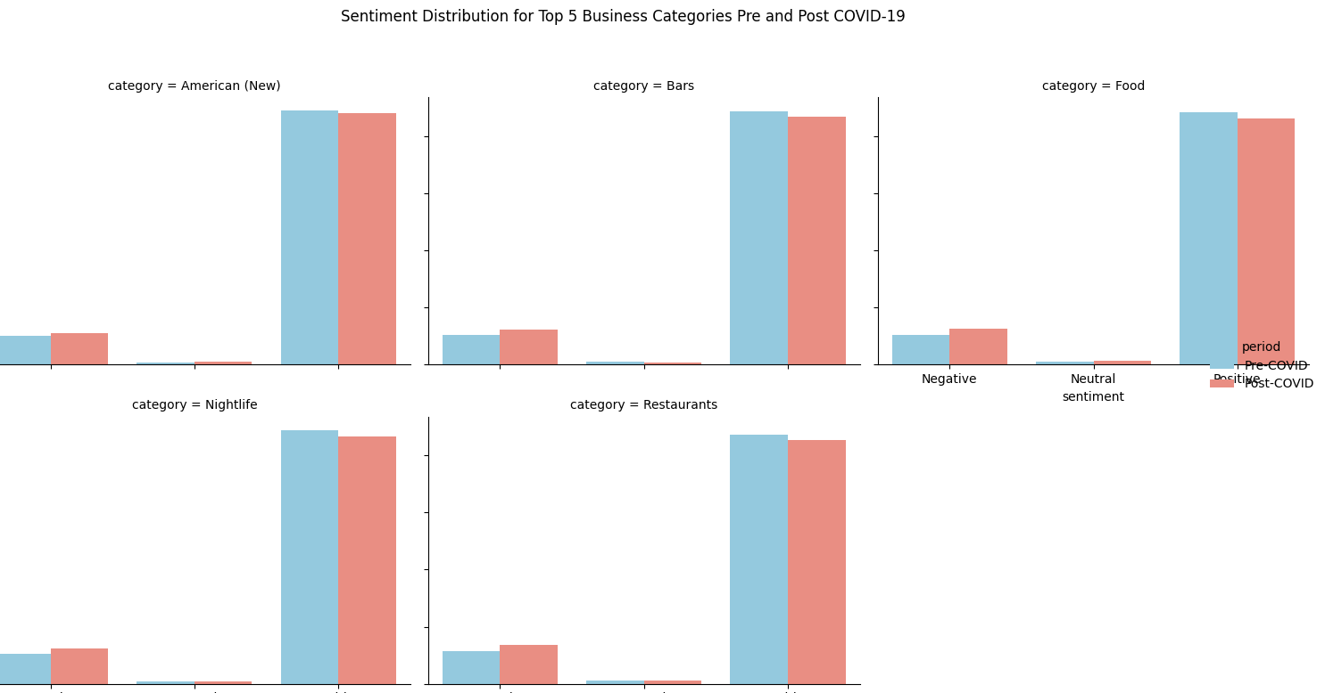
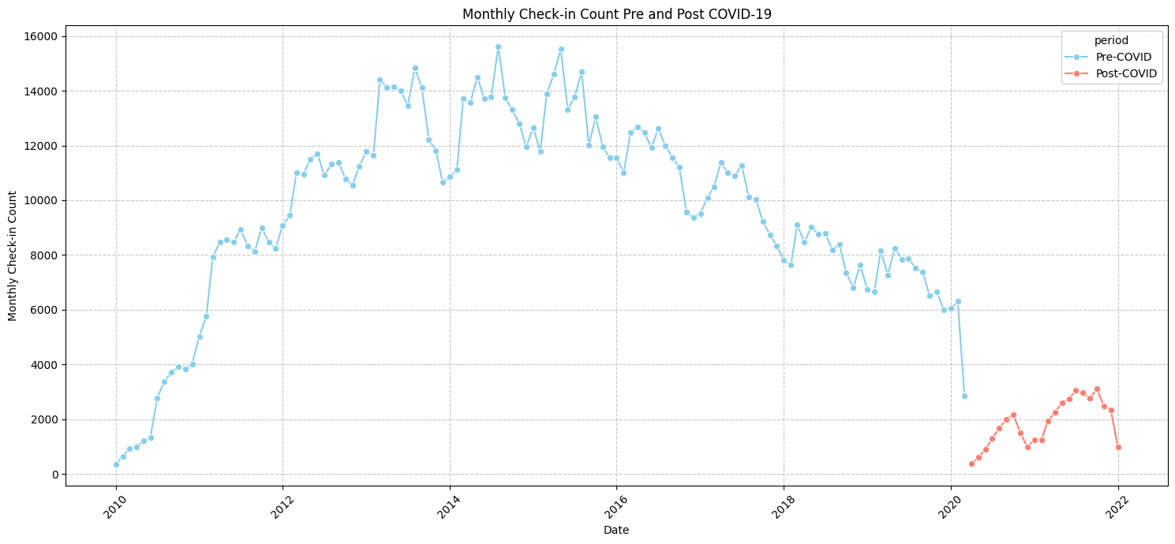
Pandemic Shock Analysis - Review Sentiment

Slide 19
Questions?

Slide 20
References
Foodylytics. (2025). Philadelphia restaurant market statistics. Retrieved from https://www.foodylytics.com/statistics/pennsylvania/philadelphia
Stacker. (2025, January 31). Highest-rated restaurants in Philadelphia by diners. Retrieved from https://stacker.com/stories/pennsylvania/philadelphia/highest-rated-restaurants-philadelphia-diners
Axios. (2024, January 24). New business openings show restaurants leading recovery in Philadelphia. Retrieved from https://www.axios.com/local/philadelphia/2024/01/24/new-business-openings-restaurants-recovery

